Slide 1

Oyo Project Report

Slide 2
Introduction
In the recent years there has been significant growth of Hotel Bookings through OYO Founded in 2013 , OYO initially consisted mainly of budget hotels. The startup expanded globally with thousands of hotels, vacation homes, and millions of rooms in hundreds of cities in India.
The analysis of hotel bookings , cancellation rate , types of bookings as well as other factors are the main topics of this report .

Slide 3
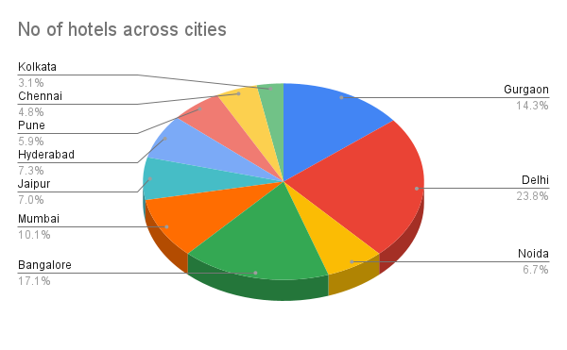
Count of Hotels across Cities
Top three cities with maximum number of hotels are Delhi , Bangalore and Gurgaon

Slide 4
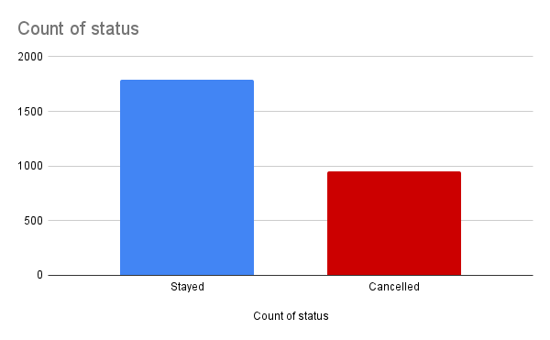
Cancellation of Bookings
Now there seems to be high cancellations across various cities thus one has to analyse as to why this number is so high

Slide 5
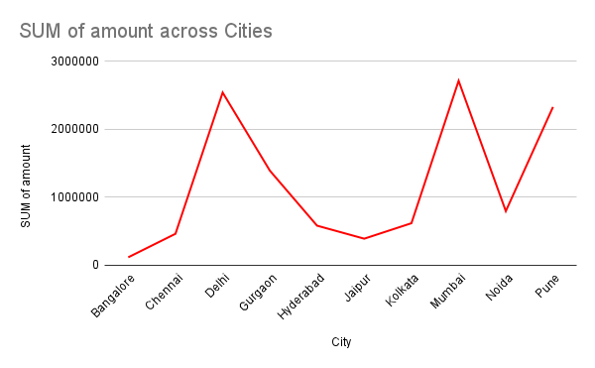
Total amount for cancelled bookings across cities
It can be seen that Mumbai has contributed to max loss due to most cancelled bookings followed by Delhi .
Also , total loss due to cancellation = canceled no. of bookings x average pay rent

Slide 6
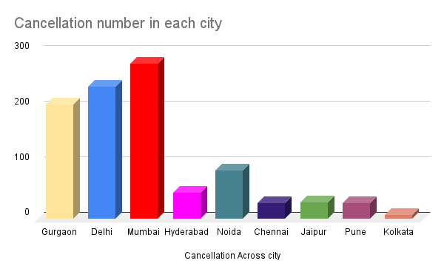
Bookings Cancelled across cities
Here it can be seen that Mumbai has the highest number cancellations followed by Delhi .

Slide 7
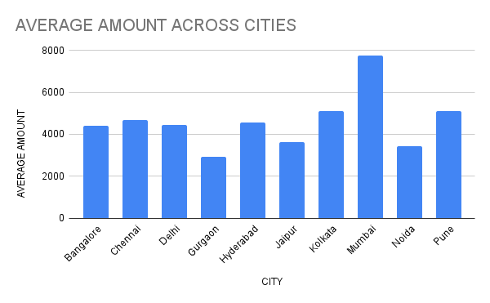
Average price of bookings
Now after further analysis it was quite evident that cancellations mainly occur because of high price as is being depicted by this graph .

Slide 8
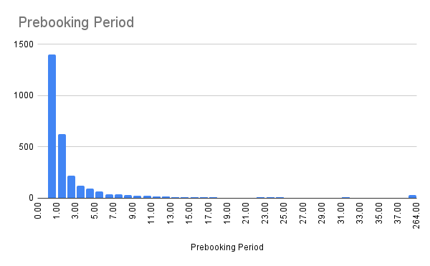
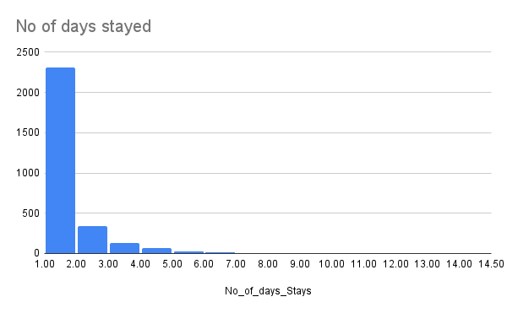
Further analysis showed following results

